Slide 1
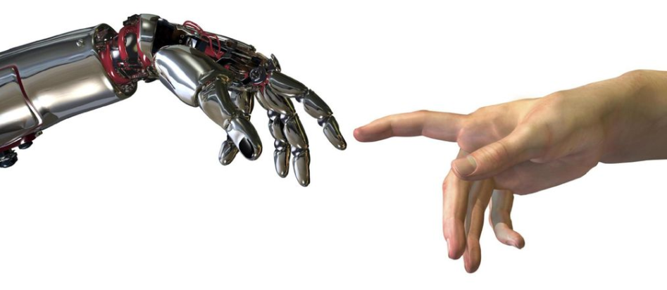
GESTURE CONTROL ROBOT USING IMAGE PROCESSING

Slide 2
Gesture Controlled Robot using Image Processing Service robots directly interact with people, so finding a more natural and easy user interface is of fundamental importance. While earlier works have focused primarily on issues such as manipulation and navigation in the environment, few robotic systems are used with user friendly interfaces that possess the ability to control the robot by natural means. To facilitate a feasible solution to this requirement, we have implemented a system through which the user can give commands to a wireless robot using gestures. Through this method, the user can control or navigate the robot by using gestures of his/her palm, thereby interacting with the robotic system. The command signals are generated from these gestures using image processing. These signals are then passed to the robot to navigate it in the specified directions. Keywords— Gestures; OpenCV; Arduino.

Slide 3
Introduction:
In today’s age, the robotic industry has been developing many new trends to increase the efficiency, accessibility and accuracy of the systems. Basic tasks could be jobs that are harmful to the human, repetitive jobs that are boring, stressful etc. Though robots can be a replacement to humans, they still need to be controlled by humans itself. Robots can be wired or wireless, both having a controller device. Both have pros and cons associated with them. Beyond controlling the robotic system through physical devices, recent method of gesture control has become very popular. The main purpose of using gestures is that it provides a more natural way of controlling and provides a rich and intuitive form of interaction with the robotic system. This mainly involves Image Processing and Machine Learning for the system or application development. Beyond this, it also requires some kind of hardware for interfacing with the system for gesture control. There are some systems that have been developed in the same field using various techniques. Many systems exist that are used for controlling the robot through gestures. Some gesture recognition systems involve, adaptive color segmentation [1], hand finding and labelling with blocking, morphological filtering, and then gesture actions are found by template matching and skeletonizing.

Slide 4
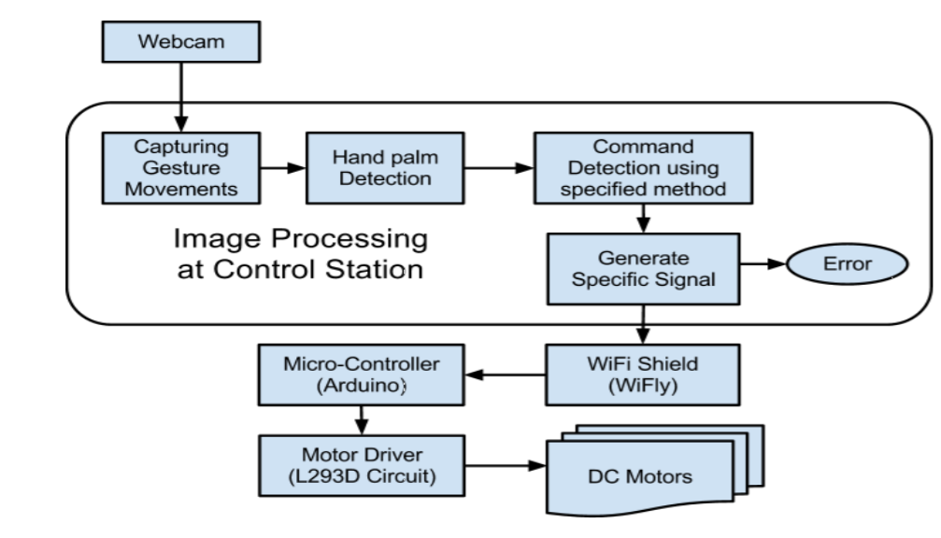

Slide 5
COMPONENTS
ARDUINO UNO
The Arduino Uno is an open-source microcontroller board based on the Microchip ATmega328P microcontroller and developed by Arduino.cc. The board is equipped with sets of digital and analog input/output (I/O) pins that may be interfaced to various expansion boards (shields) and other circuits. The board has 14 digital I/O pins (six capable of PWM output), 6 analog I/O pins, and is programmable with the Arduino IDE (Integrated Development Environment), via a type B USB cable . It can be powered by the USB cable or by an external 9-volt battery, though it accepts voltages between 7 and 20 volts. It is also similar to the Arduino Nano and Leonardo.
MOTOR DRIVER
A motor controller is a device or group of devices that serves to govern in some predetermined manner the performance of an electric motor . A motor controller might include a manual or automatic means for starting and stopping the motor, selecting forward or reverse rotation, selecting and regulating the speed, regulating or limiting the torque, and protecting against overloads and electrical faults.
There are many types of starters:
Direct On Line (DOL)
Star delta starter
Auto transformer starter

Slide 6
BLUETOOTH MODULE
HC‐05 module is an easy to use Bluetooth SPP (Serial Port Protocol) module,designed for transparent wireless serial connection setup.The HC-05 Bluetooth Module can be used in a Master or Slave configuration, making it a great solution for wireless communication.This serial port bluetooth module is fully qualified Bluetooth V2.0+EDR (Enhanced Data Rate) 3Mbps Modulation with complete 2.4GHz radio transceiver and baseband. It uses CSR Bluecore 04‐External single chip Rluetooth system with CMOS technology and with AFH (Adaptive Frequency Hopping Feature).

Slide 7
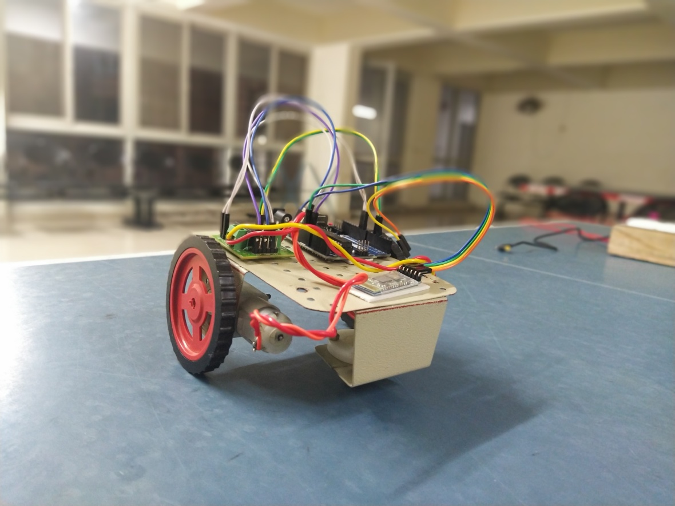

Slide 8
MOTOR
An electric motor is an electrical machine that converts electrical energy into mechanical energy. Most electric motors operate through the interaction between the motor's magnetic field and electric current in a wire winding to generate force in the form of rotation of a shaft. Electric motors can be powered by direct current (DC) sources, such as from batteries, motor vehicles or rectifiers, or by alternating current (AC) sources, such as a power grid, inverters or electrical generators.
WORKING MODEL
The device is basically managed and controlled by Arduino Uno microcontroller. The complete setup is based on the application of Open CV environment of Python which helps in processing the image and providing the right information to the users and other specified components. This library helps the computer to process an image or a video which is nothing but a collection of frames.
After processing the image the data is sent to the Arduino which has been coded to instruct the motors after receiving the signal to move in a specific manner. Each signal encodes a specific way of moving the robot in forward , left, right, backward directions respectively.
The data transfer between the Open CV python code and Arduino is achieved through Bluetooth. The buetooth connection is setup in the Arduino by a Bluetooth module HC – 05.

Slide 9
THANK YOU

